Slide 1
The Impact of Populist Parties in Government
Populism: An Introduction (Edited by Robert A. Huber & Michael Jankowski)
Fred Paxton

Slide 2
Lecture plan
The rise of populist parties into power
Challenges faced by populist parties in government
The policy impact of populist parties in government
The democratic impact of populist parties in government
Explaining variations in impact

Slide 3
The rise of populist parties into power
Increasing number of populists in government across the globe
Populists have gained support due to a crisis of representation
Different ideological varieties of populism (right or left-wing) have responded to the crisis with distinct strategies
Right-wing populists have politicized the cultural dimension of politics (e.g. immigration, multiculturalism, EU)
Left-wing populists have adopted distinctive positions on economic issues, in contrast to the mainstream parties who have converged on many similar stances

Slide 4
Challenges faced by populist parties in government
‘Inclusion-moderation’
Government responsibility may tame the radicalism of populist parties (although empirical evidence is mixed), as they must focus on policy delivery, and may have to collaborate with other parties in coalitions
Organisational challenges
Moderating in government, and failing to deliver on promises, may alienate supporters
Lack of experienced personnel, and an over-reliance on a charismatic leader, may lead to incompetent governing performances
Electoral consequences of governing
Some populist parties have suffered significant electoral losses after participating in government (but not all of them)

Slide 5
The policy impact of populist parties in government
Immigration policies
Governments involving right-wing populists have produced more restrictive immigration policies (N.B. so have many without the populists’ involvement)
Socioeconomic policies
Governments involving left-wing populists have aimed to address economic inequality through greater government intervention
Policy changes at sub-national levels of government
Populists have also influenced changes at the local level of government, e.g. culture, immigration, law and order, administrative reforms

Slide 6
The democratic impact of populist parties in government
Different perspectives on the effects of populism on democratic functioning (‘threat’ vs. ‘corrective’)
Corruption
While in opposition they thrive on promising to challenge corruption, in government the situation has tended to worsen (e.g. Venezuela of Chávez and Maduro)
Democratic safeguards
Contradicting the principles of liberal democracy (rule of law, protection of individual and minority rights) in Europe and Latin America
Benefits
Some evidence of incrased electoral turnout, equality of participation, decline in democratic dissatisfaction, increase in political trust (depending on context)

Slide 7
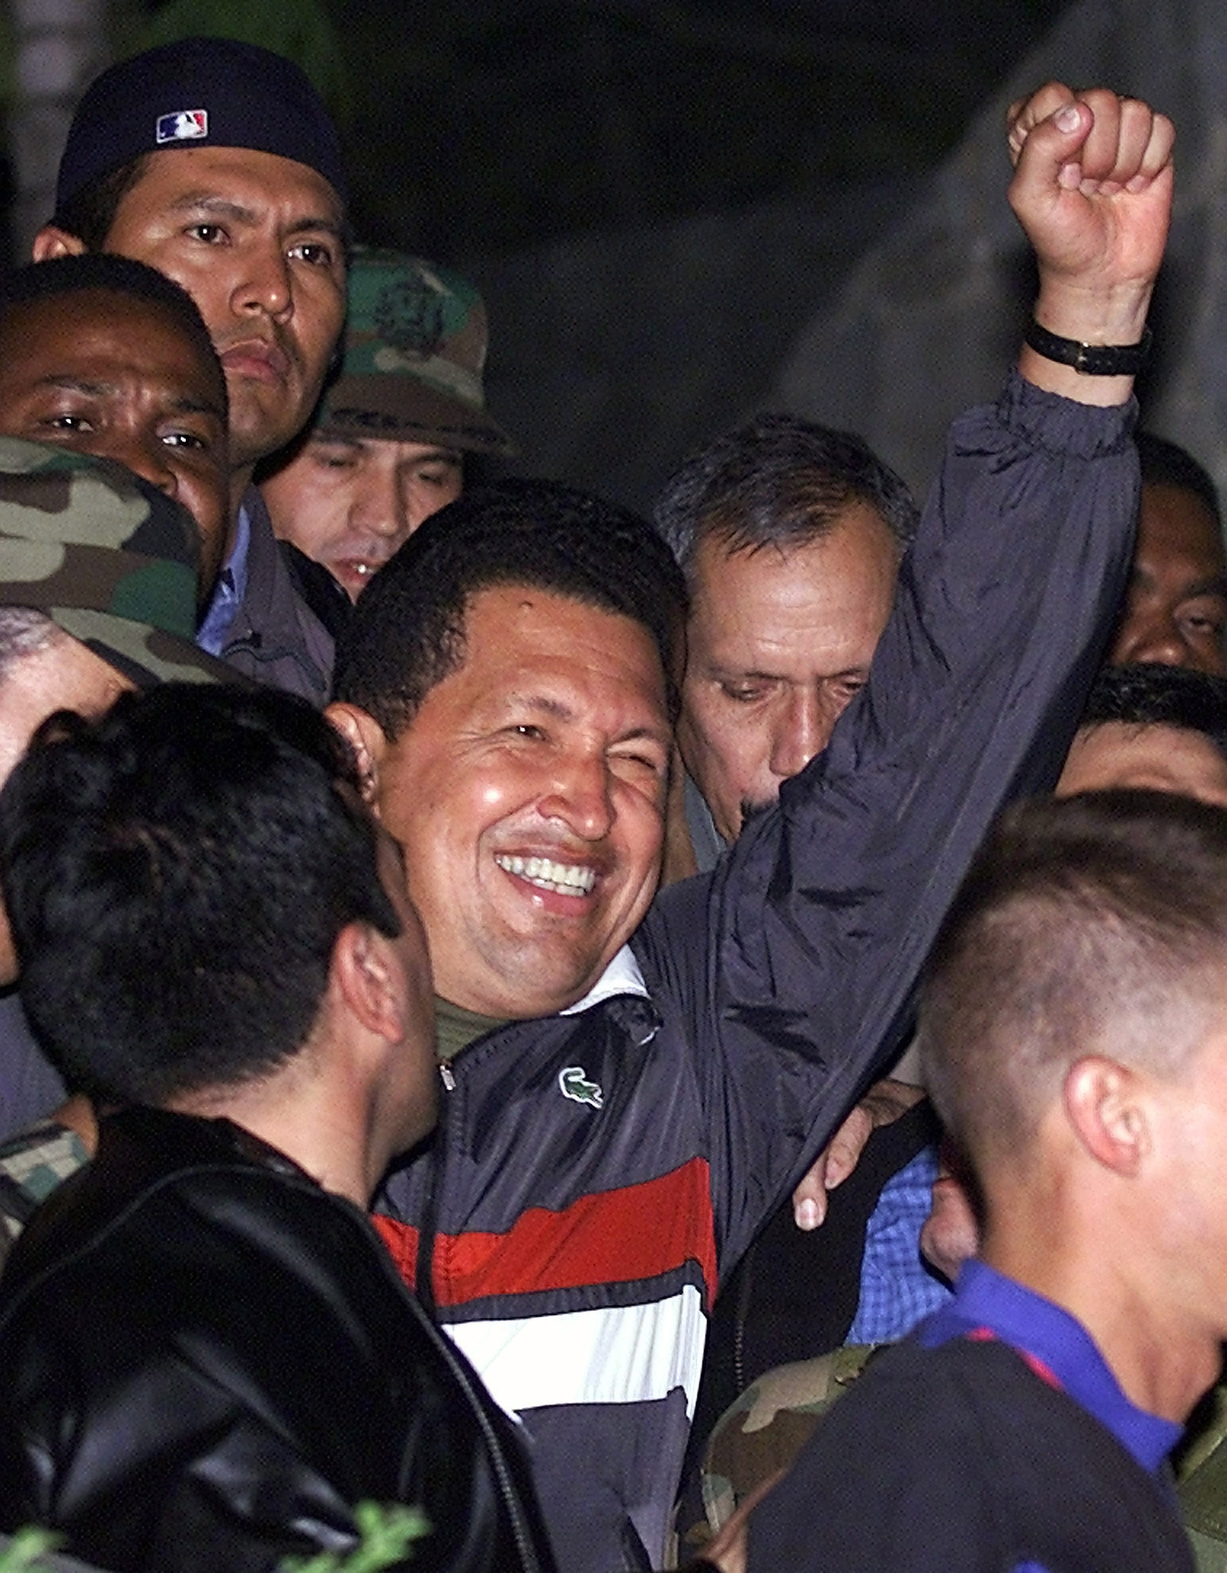
Hugo Chávez: The consequences of populism in power for democracy
Left-wing populist president of Venezuela (1999—2013)
Promised both sweeping economic changes (to reduce poverty and inequality) and institutional changes (to introduce a new, more direct form of democracy)
The constitutional changes actually led to a highly authoritarian government
Political opponents were demonized as enemies hostile to the interests of ’the people’
Power was centralized under Chávez’s personal control and high levels of corruption followed
This Photo by Unknown Author is licensed under CC BY-NC-ND

Slide 8
Explaining variations in impact
Cross-national institutional variation
Differences between parliamentary (which tend to imply coalition governments which may restrain populist parties) and presidential systems (which tend to allow populists to concentrate their own personal power)
Organizational strength
Parties with more robust organisation are more able to achieve policy objectives than those with weaknesses, and, particularly in cases of failure and compromise, more capable to manage internal tensions
Strategic choices
Balancing radicalism with the (moderating) demands of governance: whether to play the role of ‘responsible member of government’, ‘opposition in government’ – or to take a ‘one foot in, one foot out’ approach

Slide 9

FPÖ: The rise and fall (and rise again) of a populist party
Right-wing populist FPÖ in government in Austria (2000-2005)
Despite some policy changes and fiery rhetoric, the FPÖ struggled to achieve its goals
A lack of experienced personnel and many controversial actions from leader Jörg Haider
Party is punished severely in 2002 elections (27% -> 10% of cote) and splits in two, with Haider leaving to form new BZÖ party
Nevertheless, he FPÖ managed to make a comeback, re-entering the government in 2017, and as of December 2023, is the most popular party in Austria.
This Photo by Unknown Author is licensed under CC BY-SA

Slide 10
Cordon Sanitaire: debate on whether to include populist parties in government
Reasons to include | Reasons to exclude

Slide 11
Lecture review
The rise of populist parties into power
Challenges faced by populist parties in government
The policy impact of populist parties in government
The democratic impact of populist parties in government
Explaining variations in impact

